Slide 1
Teaching Bullying Prevention Strategies to School-Aged Youth
Kristen Myers, MS
Prevention Specialist
2018 Spring Training Institute

Slide 2
Bullying Statistics
More than one out of every five (20.8%) students report being bullied (National Center for Educational Statistics, 2016).
Rates of bullying vary across studies (from 9% to 98%). A meta-analysis of 80 studies analyzing bullying involvement rates (for both bullying others and being bullied) for 12-18 year old students reported a mean prevalence rate of 35% for traditional bullying involvement and 15% for cyberbullying involvement (Modecki, Minchin, Harbaugh, Guerra, & Runions, 2014).

Slide 3
Bullying Statistics cont’d.
More than half of bullying situations (57%) stop when a peer intervenes on behalf of the student being bullied (Hawkins, Pepler, & Craig, 2001).
School-based bullying prevention programs decrease bullying by up to 25% (McCallion & Feder, 2013).
“Bullying Statistics.” Bullying Statistics - National Bullying Prevention Center, Pacer's National Bullying Prevention Center, 27 Dec. 2017, www.pacer.org/bullying/resources/stats.asp.

Slide 4
How Do We Address This Problem?
Educating youth on bullying and helpful responses to bullying. Begin in early elementary.
Assisting youth in developing empathy and empathic responses to others.
Developing self-worth in youth that builds ALL youth up without tearing others down.
Supporting those who bully and those who are bullied with consistency.
Must be both home-based and school-wide.
Notes:
This model is for use with the general student population. Additional individual mental health intervention and education will be necessary for those who display consistent and increasing bullying behavior.

Slide 5
Teaching/Presentation Model
Define
Teach
Give Permission to Use

Slide 6
Missouri’s Definition of Bullying
State Law 160.775. (2016) "Bullying" means intimidation, unwanted aggressive behavior, or harassment that is repetitive or is substantially likely to be repeated and causes a reasonable student to fear for his or her physical safety or property; substantially interferes with the educational performance, opportunities, or benefits of any student without exception; or substantially disrupts the orderly operation of the school. Bullying may consist of physical actions, including gestures, or oral, cyberbullying, electronic, or written communication, and any threat of retaliation for reporting of such acts. Bullying of students is prohibited on school property, at any school function, or on a school bus.

Slide 7
Working Definition of Bullying
Someone being mean, aggressive, or hurting you
Repeatedly
In order to feel powerful and to make you feel powerless (An imbalance of power).
Notes:
Differentiate between mean moments, conflict, and teasing.

Slide 8
Differentiation
What is a Mean Moment?
vs.
What is Bullying?

Slide 9
Types of Bullying
Verbal
Physical
Pranks
Cyber
Other programs may include “Social.”

Slide 10
Why Do Students Bully?
To Feel Powerful
Jealousy
Has Been Bullied
Trouble at Home/Pressure
Revenge/Anger
Heightened Self-Esteem/Differences
Notes:
Helps to begin to lay foundation for empathy.
Reasons, not excuses.

Slide 11
“Be Cool” Paradigm
Developed by Dr. James Stanfield, Ed.D.
Based on Three Responses to Behavior
Cold (Passivity)
Hot (Aggression)
Cool (Assertiveness)

Slide 12
“Cool” Responses to Anger
The choices we make when experiencing anger continue into the choices we make when later exposed to bullying/cyberbullying!
Notes:
Primary grades

Slide 13
“Cool” Responses to Bullying
Truth & Feelings
Ignore & Walk Away
Safety & Strength in Numbers
Skipping CD/Broken Record
Agree or Disagree
Humor

Slide 14
Truth and Feelings
When you…
I feel…
Because…
I would like…

Slide 15
Ignore & Walk Away

Slide 16
Safety and Strength in Numbers

Slide 17
Skipping CD/ Broken Record

Slide 18
Agree or Disagree

Slide 19
Humor

Slide 20
Reporting Dangerous Bullying
What is “Dangerous Bullying?”
Determine “Tattling” vs. “Reporting.”
Who are “Trusted Adults?”
How to report.

Slide 21
Cyber Bullying
Begin with online safety education.
Discuss types of cyber bullying.
Give “Cool” responses to handle cyber bullying.
Teach how to “THINK.”

Slide 22
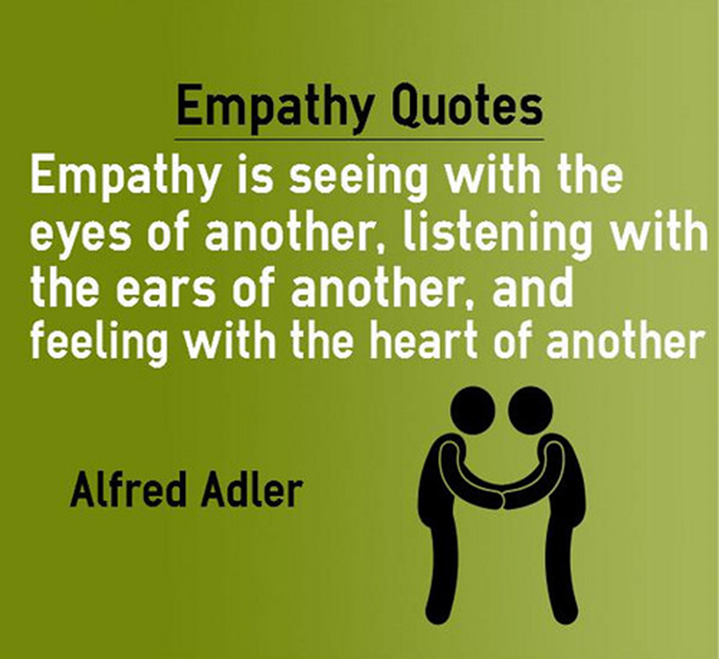
The Importance of Teaching Empathy and Self Worth
Notes:
Include videos.

Slide 23
Strategies Through Middle School and High School
Understanding diversity and acceptance.
Resolving conflicts well.
Handling loss and depression.
Identifying and stopping cyber bullying.
Recognizing “healthy relationships” in dating.

Slide 24
How To Be A Supportive Friend
Believe them.
Don’t gossip.
Don’t judge.
Tell them, “You didn’t deserve this.”
Offer resources.

Slide 25
Helping Parents Model/Teach Concepts at Home
For Younger Children
Use the common language of Hot/Cold/Cool.
Encourage parents to model cool behavior to anger/bullying.
Practice/role play cool behavior.
Encourage parents to limit aggressive behavior that youth are exposed to on TV/movies/video games.

Slide 26
Helping Parents Model/Teach Concepts at Home
For Older Youth
Assist them in talking with youth about own personal experiences and how choices impacted real life situations.
Discuss “What If’s?”
Teach importance of empathy to family members.
Emphasize healthy behavior.
Apologize and forgive regularly.

Slide 27
Supporting Evidence
In other words…Does this really make a difference?
The answer is “YES!!!”

Slide 28
Total Number Of Students Served School Year 2016 – 2017
Lincoln County: 5,548
Franklin County: 7,651
Warren County: 1,345
St. Charles County: 35,309
= Total Number Served: 49,853

