Slide 1
Gender 201 Rethinking Gender & Identity
June 1, 2018
Missouri Department of Mental Health: Spring Training Institute
Tyler McClain, MSW
Maria Whitter, MSW, LCSW, CEAP, SAP
Notes:
Both

Slide 2
Objectives
Gain knowledge of terminology and model appropriate and respectful language towards transgender individuals.
Understand the physical health care, and mental health requirements, involved in transitioning genders.
Identify mental health concerns affecting the transgender population.
Understand the current social environment.
Identify ways to support transgender individuals.
Notes:
Maria

Slide 3
Let’s Talk Gender
Notes:
Maria

Slide 4
From the Beginning
Chromosomal sex XX = female
XY = male
XX, XY, XX/XY, XXY= intersex
Intersex anatomy may not be noticeable at birth and is often discovered during puberty.
Notes:
Maria
Intersex is a set of medical conditions that feature congenital anomalies with the reproductive system. Intersex individuals are born with sex chromosomes, external genitalia, or internal reproductive systems that are not considered “standard” for male of female.
The existence of intersex individuals shows that there are not just two sexes, and our concept of birth sex is socially constructed. Biologically as a human races we all exist across a spectrum of sexual anatomy and we ourselves are creating the strict distinctions in sex.

Slide 5
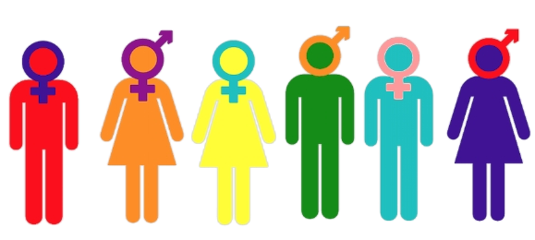
Sex-determining
Genes
Gender Identity
Hormones
Gender Behavior
Chromosomes
Gender Expression
Gender Role
Physical Anatomy
Biology
Culture
Notes:
Maria
Constructing Sex & Gender
Biological Construct: Attributes that characterize
biological maleness and
femaleness:
Cultural: Attitudes, feelings, and
behaviors that a given culture
associates with a person’s
biological sex (APA, 2011):
Varies by time, place, location

Slide 6
1
Notes:
Maria

Slide 7
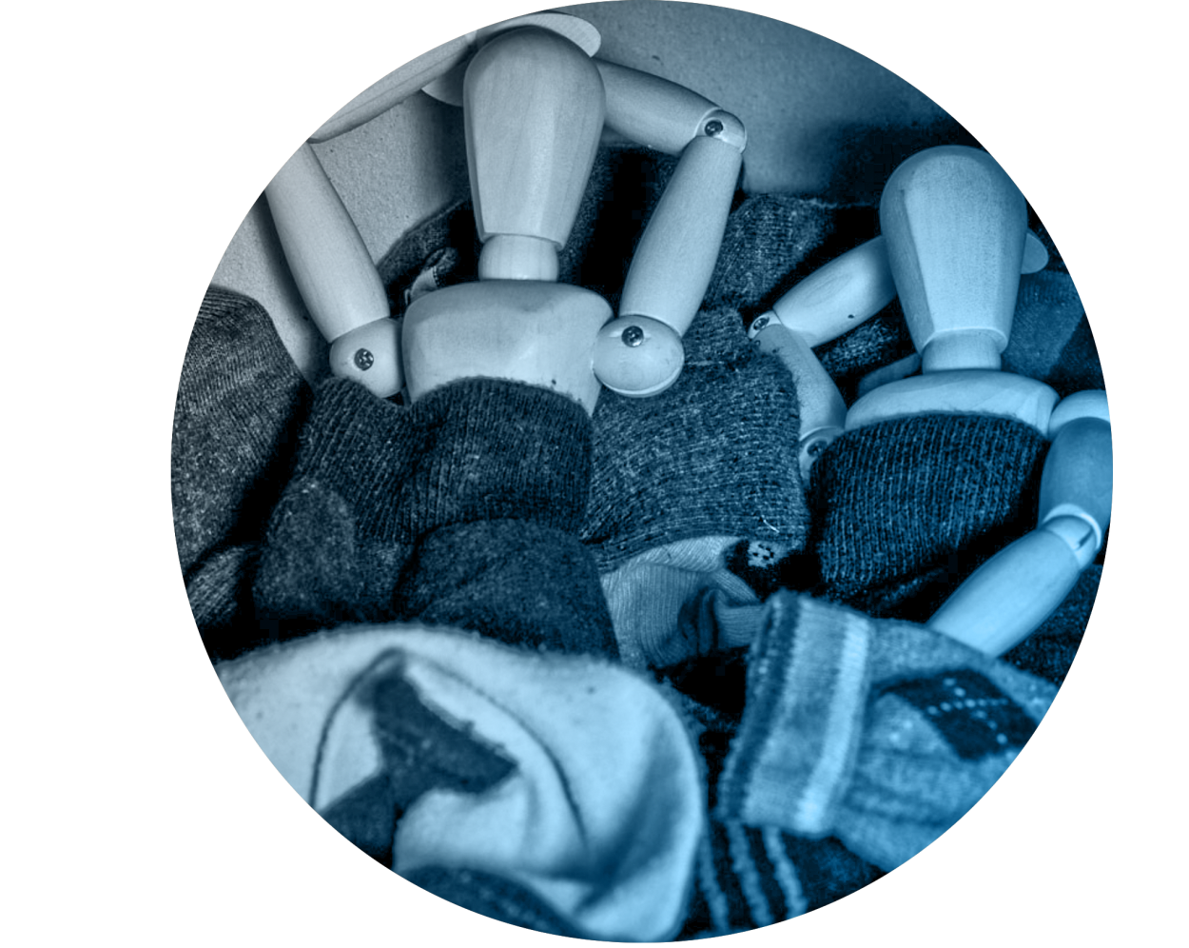
Gender Identity
Sexual Orientation
who you go to bed as
who you go to bed with
Notes:
Maria
This is a venn diagram ☺
Gender identity- who you go to bed as
Sexual orientation- who you go to bed with

Slide 8
TRANSGENDER
Non-Binary
Androgynous
Agender
Drag King
Gender Fluid
Cross Dresser
MTF
Genderqueer
Queer
FTM
Cisgender
Two Spirit
Gender Smoothie
Third Gender
Transsexual
Drag Queen
Gender Hybrid
Bigender
Notes:
Tyler
Agender – A person who is internally ungendered or does not have a felt sense of gender identity.
Androgynous - A person appearing and/or identifying as neither man nor woman, presenting a gender either mixed or neutral.
Bigender – A person whose gender identity is a combination of man and woman.
Cisgender - A person who by nature or by choice conforms to gender/sex based expectations of society (also referred to as “Gender-straight” or “Gender Normative”).
Nonbinary – Any gender that does not fit the male/female binary or cisgender definition.
FTM/F2M - Abbreviation for a female-to-male transgender or transsexual person.
Gender Fluid - A person whose gender identification and presentation shifts, whether within or outside of societal, gender-based expectations.
Gender Non-conforming - A person who doesn't conform to society's expectations of gender expression based on the gender binary, expectations of masculinity and femininity, or how they should identify their gender.
Gender-Neutral/Gender-Inclusive - Inclusive language to describe relationships (“spouse” and “partner” instead of “husband/boyfriend” and “wife / girlfriend”), spaces (gender-neutral/inclusive restrooms are for use by all genders), pronouns ("they" and "ze" are gender neutral/inclusive pronouns) among other things.
MTF/M2F - Abbreviation for male-to-female transgender or transsexual person.

Slide 9
A Transgender
He/she
Dyke
Tranny
Friend
Queer
It
Transvestite
Transgendered
Transgenders
Shim
Born a man/woman
She-male
Fag
Notes:
Tyler

Slide 10
Let’s talk pronouns
HIM
ZE
…
SHE
HER
THEM
ZIR
HE
THEY
Notes:
Tyler
What pronouns do you normally associate with gender?
Why are pronouns important?

Slide 11
2
Notes:
Maria
Gender inclusive, gender neutral spaces

Slide 12
3
9% denied access to a restroom.
12% verbally harassed when using a restroom.
59% avoided using a public restroom because they were afraid of confrontations or other problems they might experience.
32% limited the amount they ate and drank to avoid using the restroom.
8% reported a urinary tract infection, kidney infection, or another kidney-related problem as a result of avoiding restrooms.
Notes:
Maria
All stats “In the past year…..”

Slide 13
Tyler’s Story

Slide 14
Healthcare
50% reported that they had to teach their providers about transgender health.
4
3
33% had a negative experience with a healthcare provider in the last year.
23% did not seek needed healthcare due to fear of being mistreated.
3
25% experienced a problem in the past year with their insurance, such as being denied coverage for either transition-related or routine care.
3
Notes:
Maria
55% of those who sought coverage for transition-related surgery in the past year were denied, and 25% of those who sought coverage for hormones in the past year were denied.

Slide 15
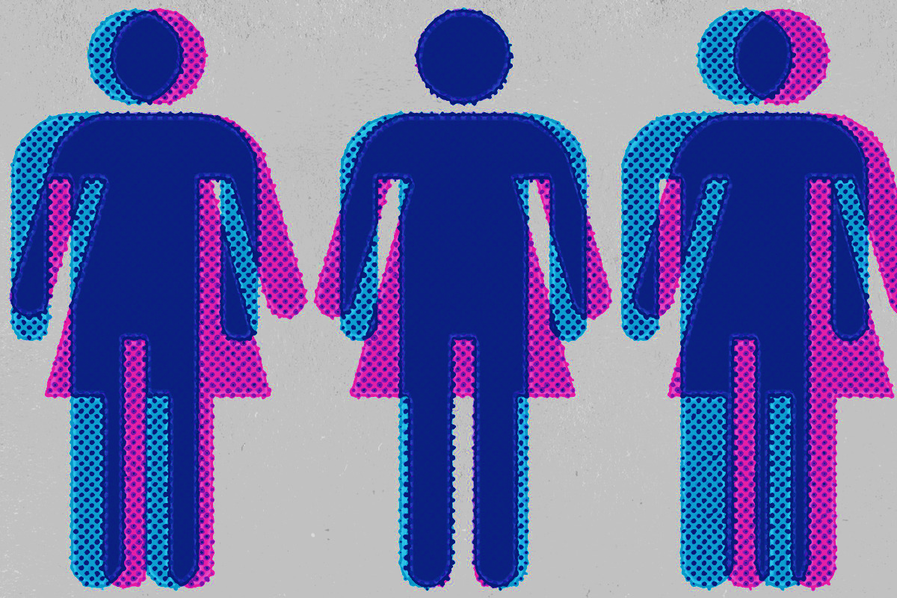
Gender Dysphoria
5
Dysphoria: a state of feeling very unhappy, uneasy, or dissatisfied.
DSM-IV: Condition was termed Gender Identity Disorder.
DSM-V: Principle criteria: Clinically significant distress resulting from a marked incongruence between one’s experienced/expressed gender and assigned gender.
6
Notes:
Maria

Slide 16
What does gender dysphoria feel like?
7
Each individuals experience is unique.
Anxiety and depression, especially in strictly gendered spaces.
Disconnect from body and emotional self.
Going through the motions of a prescribed social script.
Knowing you’re somehow different from everyone and wishing to be normal.
Notes:
Maria

Slide 17
I didn’t realize who I was until I stopped being who I wasn’t.
-Sri Gawn Tu Fahr
Being transgender is not just a medical transition. It’s discovering who you are, living your life authentically, loving yourself, and spreading that love towards other people and accepting one another no matter their difference.
- Jazz Jennings
Notes:
Maria

Slide 18
Traditional Transitioning Process
STEP 1
STEP 2
STEP 3
STEP 4
Mental health evaluation, counseling, and diagnosis of Gender Dysphoria.
Hormone therapy:
- MTF take estrogen.
- FTM take androgens.
Real life test:
person lives as the new gender for 1-2 years.
Sexual Reassignment Surgery (Gender Confirming Surgery).
Notes:
Tyler
Youth were not really considered as much in the traditional process.
Still a gender binary paradigm.

Slide 19
New Options for the Transition Process
Adults | Paradigm Shift Includes all transgender individuals in discussions about transitioning, not just those seeking medical interventions | Individualized Transition Individuals choose their desired path for transition, which may include temporary or permanent changes | Informed Consent Laws In these states, transgender individuals are not required to go through a yearlong real life test period prior to accessing gender confirmation surgery
Youth | Young Children Often present as the gender with which the identify prior to puberty | Hormone Blockers Delay the onset of puberty | Delayed Decision-Making Regarding hormone and surgical treatment until late teenage years
Notes:
Tyler

Slide 20
Barriers to Transitioning
Emotional
Social
Structural
Physical
Economical
Political
Notes:
Tyler
Healthcare- Physical
Environmental
Social
Emotional
Safety- Physical
Money- Economical
Political

Slide 21
The Cost of Being Transgender
3
15% unemployed.
20% turn to sex work, drug sales, or
other criminalized activity to survive in their lifetime.
29% lived in poverty.
23% experienced housing discrimination (e.g. evicted or denied housing).
30% experienced homelessness.
70% of those who stayed in a homeless shelter reported mistreatment.
Notes:
Maria
Based on 2014 data collected and analyzed by National Center for Transgender Equality. 2015 U.S. Transgender Survey
15% unemployed- 3X national average

Slide 22
The Cost of Being Transgender
3
54% of K-12 students were verbally harassed, 24% were physically attacked, 13% were sexually assaulted.
47% of adults reported being sexually assaulted in their lifetime.
54% experienced some form of intimate partner violence.
58% reported some form of mistreatment by police.
39% experienced severe psychological distress in the past month.
40% attempted suicide in their lifetime.
Notes:
Maria

Slide 23
Encouraging Changes
60% reported their immediate family was supportive.
3
68% reported their coworkers were supportive.
3
56% report their classmates were supportive.
3
71% fewer symptoms of severe depression when able to use chosen name.
8
65% decrease in suicide attempts when able to use chosen name.
8
Notes:
Maria
First 3 data points: Those who said that their immediate families were supportive were less likely to report a variety of negative experiences related to economic stability and health, such as experiencing homelessness, attempting suicide, or experiencing serious psychological distress.
Last 2 data points: For transgender youthg
‘’When I see you through my eyes, I think that we are different.
When I see you through my heart, I know we are the same.’’
-Doe Zantamata

Slide 24
How to be supportive
Use the individual’s name.
Be mindful to use the appropriate pronouns.
If you’re unclear about pro-nouns , names or wishes, ask respectfully. Typically folks are willing to share .
Educate yourself with legitimate resources.
Challenge your own preconceptions.
Don’t engage in gossip or share the individuals story unnecessarily.
Don’t ask about physical anatomy.
Treat others the way you want to be treated – with dignity and respect.
Notes:
Tyler

Slide 25
Professional Support
9
Provide resources and referrals for options for gender identity and expression, including medical interventions.
If applicable, assess eligibility, prepare, and refer for hormone therapy and gender confirming surgery.
Assess, diagnose, and treat co-existing mental health conditions.
Support families through the transition process.
Write a carry letter.
Assist clients with making changes in identity documents.
Become knowledgeable of WPATH best practices and standards of care.
Notes:
Tyler

Slide 26
It is revolutionary for any trans person to choose to be seen and visible in a world that tells us we should not exist.
- Laverne Cox
Notes:
Maria

Slide 27
KEY TAKEAWAYS:
How is this information important?
Share one takeaway that you will use moving forward.
Notes:
Maria

Slide 28
Resources

Slide 29
Content Sources
1. ItsPronouncedMetrosexual.com (2015).The Genderbread Person v3.3. http://u1kwao9i7u9xyle2hibw4g6h.wpengine.netdna- cdn.com/wp-content/uploads/2015/03/Genderbread-Person-3.3-HI-RES.pdf
2. Bathroom Image. http://www.pinknews.co.uk/2015/08/29/another-university-is-scrapping-he-and-she-for-gender-neutral- pronouns/
3. National Center for Transgender Equality (2016). The Report of the 2015 U.S. Transgender Survey, Executive Summary. https://transequality.org/sites/default/files/docs/usts/USTS-Executive-Summary-Dec17.pdf
4. Grant, Jaime M. Ph.D., et. al. (2010). National Transgender Discrimination Survey Report on Health and Health Care. http://www.thetaskforce.org/static_html/downloads/resources_and_tools/ntds_report_on_health.pdf
5. “dysphoria.” In Merriam-Webster.com (2018). https://www.merriam-webster.com/dictionary/dysphoria
6. American Psychiatric Association (2013). Diagnostic and statistical manual of mental disorders (5th ed.). Washington, DC.
7. Jones, Zinnia (2013). “That was dysphoria?” 8 signs and symptoms of indirect gender dysphoria. Retrieved from https://the- orbit.net/zinniajones/2013/09/that-was-dysphoria-8-signs-and-symptoms-of-indirect-gender-dysphoria
8. University of Texas at Austin (2018). Using Chosen Names Reduces Odds of Depression and Suicide in Transgender Youths. Retrieved from https://news.utexas.edu/2018/03/30/name-use-matters-for-transgender-youths-mental-health.
9. The World Professional Association for Transgender Health. Standards of Care for the Health of Transsexual, Transgender, and gender Nonconforming People, 7th Version. https://www.wpath.org/media/cms/Documents/Web%20Transfer/SOC/ Standards%20of%20Care%20V7%20-%202011%20WPATH.pdf
Garofalo, Robert, MD, MPH. Understand Gender Nonconformity in Childhood and Adolescence. Ann & Robert H. Lurie Children’s Hospital of Chicago, Gender & Sex Development Program. https://www.aap.org/enus/Documents/ solgbt_webinar_transition_garofalo.pdf

