Slide 1
Using Self Care Skills to relieve adverse effects of toxic stress and trauma- a Mind-Body Skills approach.
Rajeev John MSW, LCSW,
Manager, Adult Behavioral Health
(Certified Practitioner of Mind Body Medicine)
Thomas Kuciejczyk-Kernan MD
Board certified in Integrative and Family Medicine
Faculty member of the Center for Mind-Body Medicine

Slide 2
Mind-Body Medicine
Using the mind to affect the body
And the body to affect the mind
Through self-care practices
That mobilize innate healing dynamics

Slide 3
Innate Healing Dynamics
Induce relaxation response to relieve toxic stress
Heal trauma by relieving hyper-/hypo-arousal, facilitating grieving, and promoting reintegration
Cultivate self-awareness to empower self-direction
Positively channel emotional energy
Reduce chronic toxic systemic inflammation
Access inner resources: imagination, intuition, wisdom, and self-compassion
Good connection with others and spiritual ground

Slide 4
MBM works with our nature
We are an integrated system:
Perception, thought and emotion in the brain
Affect regulatory systems: nervous, immune, endocrine
Neurotransmitters, cytokines, hormones
Affect tissue state & function:
cardio-resp-vasc, gut-metab-renal, repro, musculo-sleletal
Tissues produce physiol effects & messengers that
Feedback to regulatory systems and affect brain state
“psycho-neuro-immuno-endocrino-logy”, MB soup
Everything happening in the mind affects the body, and everything happening in the body affects mind.

Slide 5
Hypothalmus / ANS Organ Systems | Tense Mode (Sympathetic) | Stuck in the Tense Mode: TOXIC STRESS
Cardiovascular | Faster heart rate Higher blood pressure Increased blood clotting Less blood flow to skin | palpitations chest pain thrombosis cold hands and feet
Musculature | Tense muscles | headache, neck pain muscle cramps, back pain
Metabolism | Higher blood sugar and fats Higher cortisol | hi cortisol > central obesity insulin resistance > syndrome
Gastrointestinal | Less intestinal blood flow Less intestinal movement Less digestive secretions | gastroesophageal reflux dyspepsia, indigestion gas/bloating, diarrhea, constipation
Reproductive | Suppressed genital parasymp fxn | ↓ sexual arousal (vag trans lub)
Immune System | Acquired Immunity LESS protective Innate Immunity MORE reactive | increased systemic inflammation impaired wound healing
Brain & Thinking | Hyper-alert Closed defensive thinking Aggressive behavior | tense, fearful, insomnia, fatigue poor concentration, distractibility irritability, anger

Slide 7
Optimized for Healing, Growth, & Reproduction | Relaxed Mode (Parasympathetic) | Hypothalmus / ANS Organ Systems
Full circulation to all organs (less thrombosis) | Normal heart rate Normal blood pressure Less blood clotting Increased blood flow to skin | Cardiovascular
Flexible muscles | Relaxed muscles | Musculature
Normal metabolism | Lower blood sugar and fats Lower insulin, cortisol | Metabolism
Good digestion of food, absorption of nutrients elimination of waste | More digestive secretions More intestinal blood flow More intestinal movement | Gastrointestinal
Ovulation & Spermatogenesis Conception < Coitus Childbirth Breastfeeding | Normal GnRH > FSH & LH outflow Normal sexual arousal Oxytocin enhances labor Prolactin > lactation | Reproductive
Resistance to infection Resistance to cancer Lower systemic inflammation Faster wound healing | Acquired Immunity more protective Innate Immunity less reactive | Immune System
Relaxed awareness Better learning Creative problem solving Engagement with others | Calm alertness Open receptive thinking Cooperative relational behavior | Brain & Thinking

Slide 8
Responses to Threat
Fight or Flight
Play Dead

Slide 9
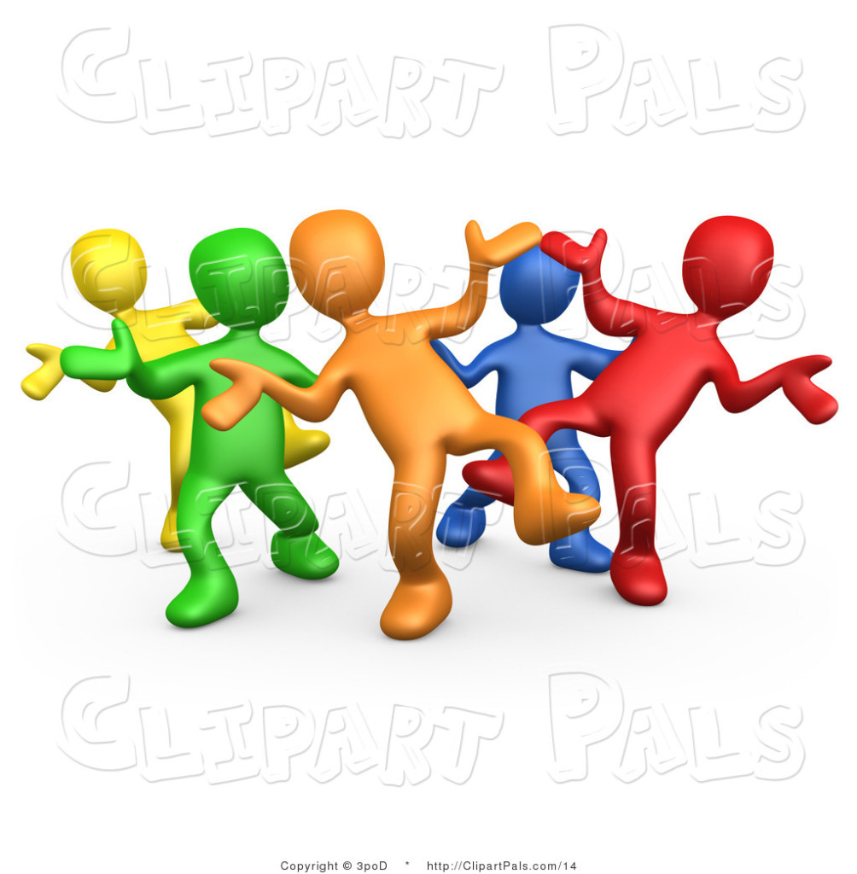
Active / Expressive Meditation
Shaking and Dancing

Slide 10
Active Meditation
Meditation
Oldest Form – original culture examples
Getting to clear and still mind, refreshed, calmly awake and energized

Slide 11
How Active Meditation Works
Body affects mind
Relaxation response relieves stress (animals shake)
Getting unstuck from Play Dead
Escaping thought loops
Moving > BDNF > new neural networks > learning
Mobilizes stuck emotion, grief relief
Returning to enjoy the present moment

Slide 12
Mind Body Skills Group model
Group Format
Ground rules: respect confidentiality no fixing
Mindful self-learning

Slide 13
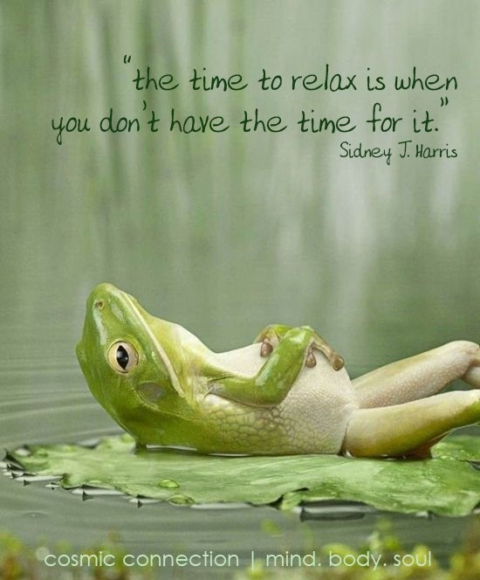
Relaxation: the beginning of MBM

Slide 14
Relaxation Practice
Effective even as stressors persist
Enhances ability to cope effectively
Awakens a locus of control: very helpful when threatened (no control terrifying)
Engenders self-efficacy (there’s something I can do about it) > empowerment > hope
Mobilizes innate resources for healing, being more well, coping with difficulty, prevention

Slide 15
Relaxed awareness Better learning Creative problem solving Engagement with others | Calm alertness Open receptive thinking Cooperative relational behavior | Brain & Thinking | Tense Fearful Irritable Angry Insomnia Fatigue Poor Concentration Easily distracted | Anxiety disorders Depression Relational conflict Professional burnout

Slide 16
Mind Body self awareness and expression
to self discover
to tap in to our own inner resources

Slide 17
Initial Drawings
You are now
You with your biggest problem
You with the problems solved

Slide 18
Meditation

Slide 19
Meditation
3 Types: Concentrative, Mindfulness, Active or Expressive
Benefits
Brain
Increase in neurotransmitter level
Increase in grey matter
Increase in serotonin, melatonin, endorphins
Increase in “alpha waves” in brain
Positivity, love and happiness

Slide 20
Guided imagery

Slide 21
Autogenics and Bio-feedback

Slide 22
Exercise and movement

Slide 23
Awareness of Emotions
YES / NO shouting exercise!

Slide 24
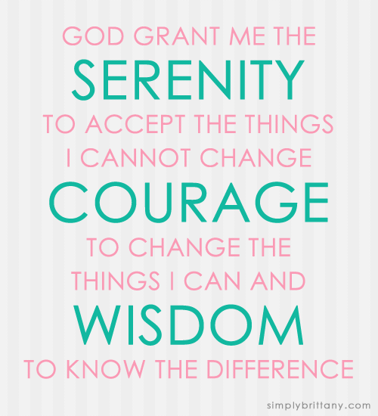
Spirituality
Power of Faith, Hope
- praying for others
- placebo effect
Forgiveness – imagery
Loving Relationship
- resilience
- healing

Slide 25
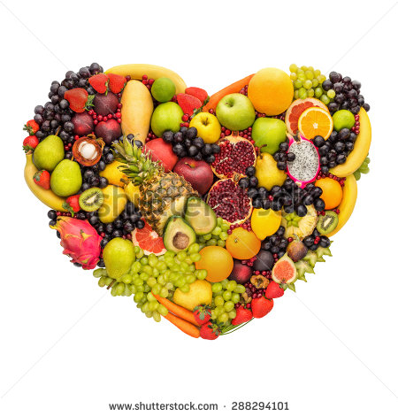
Healthy Eating
Relationship with food
Emotional
Serotonin spike
with junk food
“what we eat = who we are”

Slide 26
Mindful Eating
Drawing
Emotional connections
Mindful eating exercise

Slide 27
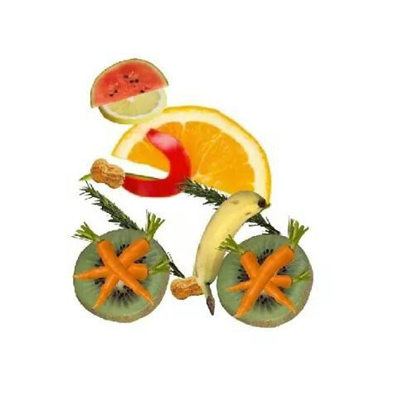
Mindful Eating- Benefits
Enjoyment
Eating with intention
Eating less
Better digestion
Nutritional benefit

Slide 28
Genogram
Family history
Self awareness of patterns
Connecting missing links
Resources

Slide 29
Ideal Self Imagery

Slide 30
Final Drawings
Where you are now
Where you want to be
How you’re going to get there

Slide 31
MBSG applications in trauma
New York City after 911
US Military after returning home (Minneapolis & San Fran VA)
New Orleans after flooding
Maryland after flooding
Pine Ridge Lakota Sioux teenage suicide epidemic
Texas after flooding
Kosovo after Bosnian War
Gaza after bombings
Israel after bombings
Haiti after earthquake
Jordan with Syrian refugees

Slide 32
Evidence for efficacy in trauma
Staples JK, Abdel Attai JA, Gordon JS. Mind-body skills groups for posttraumatic stress disorder and depression symptoms in Palestinian children and adolescents in Gaza. Int J Stress Manag. 2011; 18(3): 246-262. doi: 10.1037/a0024015
500 children participated in mind-body skills groups taught by 31 CMBM trained health professionals in Gaza in 2007-2008. Prior to participation in the program, 26% of the children had symptoms which qualified them as having PTSD. In those having qualifying PTSD symptoms, the PTSD symptom scores were significantly decreased (56%) following the program. This improvement was partially maintained at 7 month follow-up with a 39% decrease in scores compared to baseline.
56% of those qualifying as having PTSD also qualified as having depression using cutoff values on the Children’s Depression Inventory. The depression scores were significantly decreased (29%) following the program. This improvement was partially maintained at 7 month follow-up with a 20% decrease in scores compared to baseline. The children felt more hopeful about their future and their lives as indicated by a statistically significant decrease in hopelessness scores (28% decrease) following participation in the mind-body skills groups. This improvement was fully maintained at follow-up.

Slide 33
Evidence for efficacy in trauma
Gordon, James S., Staples, Julie K., Blyta, Afrim, Bytyqi, Murat and Wilson, Amy T. Treatment of Posttraumatic Stress Disorder in Postwar Kosovar Adolescents Using Mind-Body Skills Groups: A Randomized Controlled Trial. Journal of Clinical Psychiatry, 2008 Sep;69 (9):1469-76.
This study demonstrates that CMBM’s groundbreaking model can be used to produce highly significant and lasting changes in levels of posttraumatic stress symptoms in highly traumatized children.
82 high school students in Kosovo participated in this randomized-controlled study. The program was conducted by teachers in an educational, supportive small group setting and included meditation, guided imagery, breathing techniques, and biofeedback as well as self-expression through words, drawings, and movement. All the students met the criteria for posttraumatic stress disorder (PTSD) which was measured using the Harvard Trauma Questionnaire. Following the program, the number of students having symptoms indicating PTSD was significantly reduced from 100% to 18%. The reduction in symptoms was maintained at a 3 month follow-up.

Slide 34
Our training with CMBM
Center for Mind-Body Medicine (www.cmbm.org)
Initial Professional Training Program – self-care
Advanced Training Program – facilitating groups
Certification Program – personal supervision

Slide 35
Training in Mind-Body Medicine

Slide 36
Questions? Comments !
Thomas K Kernan, MD
(314)898-1748
thomask@affiniahealthcare.org
Rajeev John, MSW, LCSW
(314)814- 8755
rajeevj@affiniahealthcare.org

